Slide 1

Case Study 2
Chris Johnson

Slide 2

Objective
DDSAnalytics is an analytics company that specializes in talent management solutions for Fortune 100 companies
Use Data Science techniques to help identify factors that lead to Attrition, as well as any trends in the data
A data file was used with data for 870 employess that include multiple variables regarding their employment

Slide 3

Categorical Variables
First, identify categorical variables of significance
Business Travel
Department
Education Field
Gender
Job Role
Marital Status
Overtime

Slide 4
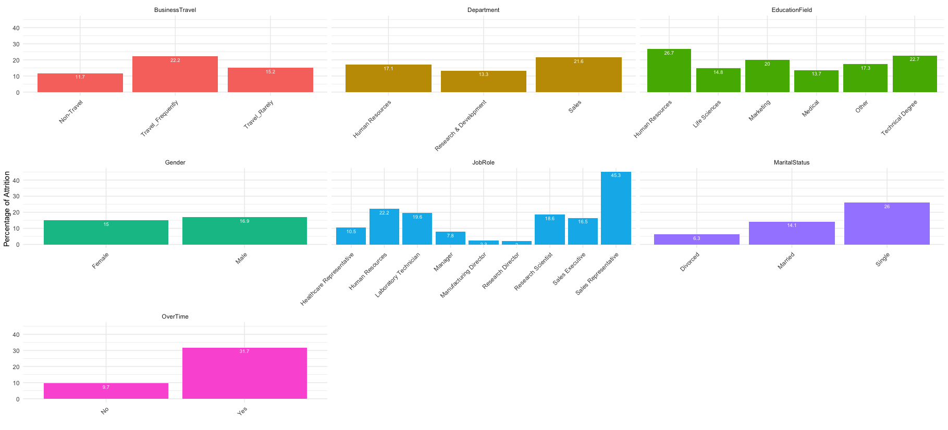

Slide 5
Highest and Lowest Attrition
Category | Lowest | Highest
Business Travel | No Travel | Travels Frequently
Department | R&D | Sales
Education Field | Medical Degree | Human Resources Degree
Gender | Female | Male
Job Role | Research Director | Sales Rep
Martial Status | Divorced | Single
Overtime | No | Yes

Slide 6
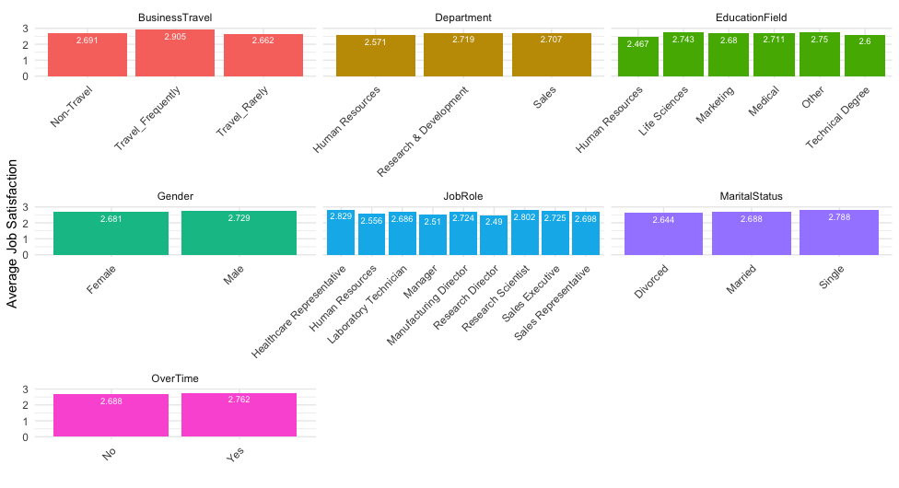

Slide 7

Job Satisfaction
Only Human Resources Degree and Overtime had a positive correlation between attrition and job satisfaction

Slide 8
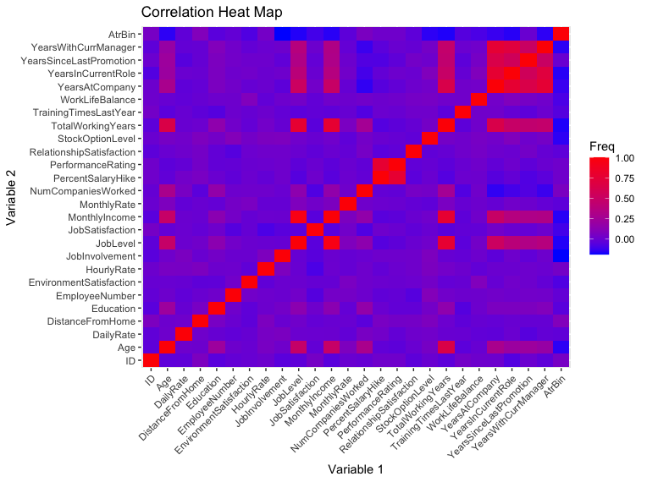
Modeling
Transformed attrition into a binary number (1=Yes, 0=No) and made a correlation heatmap to find correlated factors.
Lack of continuous variable made correlation difficult

Slide 9

KNN Model
Using the 4 highest corelated variables from the heatmap (HourlyRate, TotalworkingYears, DistanceFromHome and Age) a KNN model was made
A loop was made to test for the best k-value to find the highest possible sensitivity and specificity
The highest specificity achieved was 0.2857. Lower than the desired specificity of 0.6

Slide 10

NaiveBayes
NaiveBayes Model yielded better results
Accuracy: 0.8467
Sensitivity: 0.8904
Specificity: 0.6190

Slide 11

Salary Model
Find a model that can predict Monthly Income with a RMSE less than $3000

Slide 12
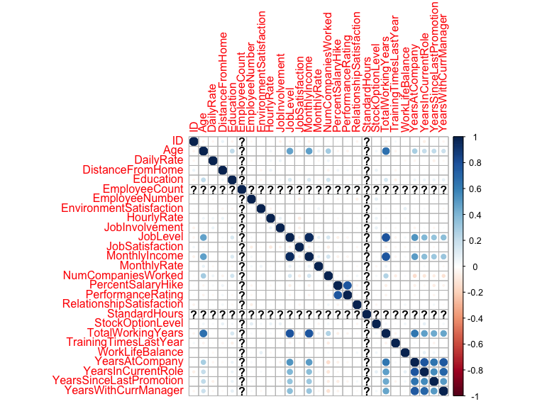
Salary Correlation
Salary is numeric column
Heatmap showw correlated fields
JobLevel
TotalWorkingYears
YearsAtCompnay
Age

Slide 13

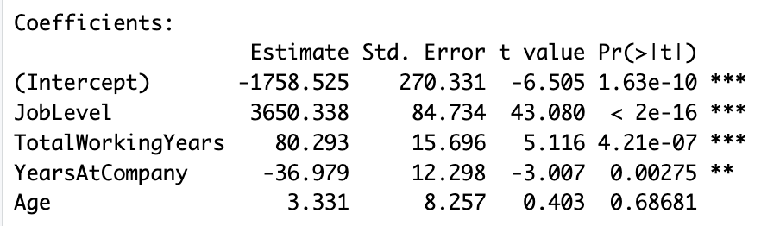
Final Model
Final Model yielded an RMSE of $1432.01

Slide 14


